Slide 1
Course: Psychology of Communication General topic: Basic principles of communication
Lecturer: Olena Lutsenko
Professor of Department of Clinical Neurology, Psychiatry and Narcology, Doctor of Science in Psychology

Slide 2
Today’s learning outcomes
Topic 1. Communicational competence
Introduction. Course structure. Methods of assessing the acquisition of the course. Basic definitions.
Topic 2. Types of communication. Characteristics of communication
Verbal and non-verbal. Formal and informal. Communicational styles. Communicational principles. Conveying the message. Listening. Feedback.

Slide 3
What is communicational competence?
Communication is simply the act of transferring information from one place to another, no matter whether it is vocal (using voice), written (using printed or digital media such as books, magazines, websites or e-mails), visual (using logos, maps, charts or graphs) or non-verbal (using body language, gestures and the tone and pitch of voice).
How well this information can be transmitted and received is a measure of how good our communication skills are.

Slide 4
Definition
Communication (from Latin «communis», meaning «to share») is the activity of conveying information through the exchange of thoughts, messages, or information, as by speech, visuals, signals, writing, or behavior.

Slide 5
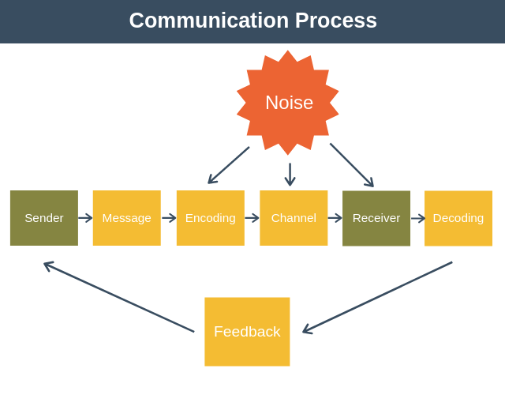

Slide 6
Stages of communication process
1. Conveying the information. At this stage we send verbal and nonverbal information to somebody.
2. Absorption of external information. Namely through sense organs we simply absorb the sounds and colors, the spoken words and all external data provided to us.
3. Interpretation of information involves using brain mechanisms and analyzing external stimuli as well as details such as expressions and subtle verbal and non-verbal cues, so interpretation is a subjective process.
4. Reaction to the information uses physical communication routes such as speech, language or expressions through facial, bodily movements and any other behavior.

Slide 7
Types of communication
Types | Basis of communication | Types of communication
1. | Types of communication based on the communication channels used | – verbal communication (oral and written communication); – non-verbal communication
2. | Types of communication based on purpose | – formal communication; – informal communication
3. | Types of communication based on effectiveness and content | – informative communication; – affective communication; – indispensable communication

Slide 8
4. | Types of communication based on the number of participants | – intrapersonal communication; – interpersonal communication
5. | Types of communication based on the extent to which the interaction is shared | – small group communication; – public communication
6. | Types of communication based on the communicative stile | Assertive Aggressive Passive-aggressive Submissive Manipulative

Slide 9
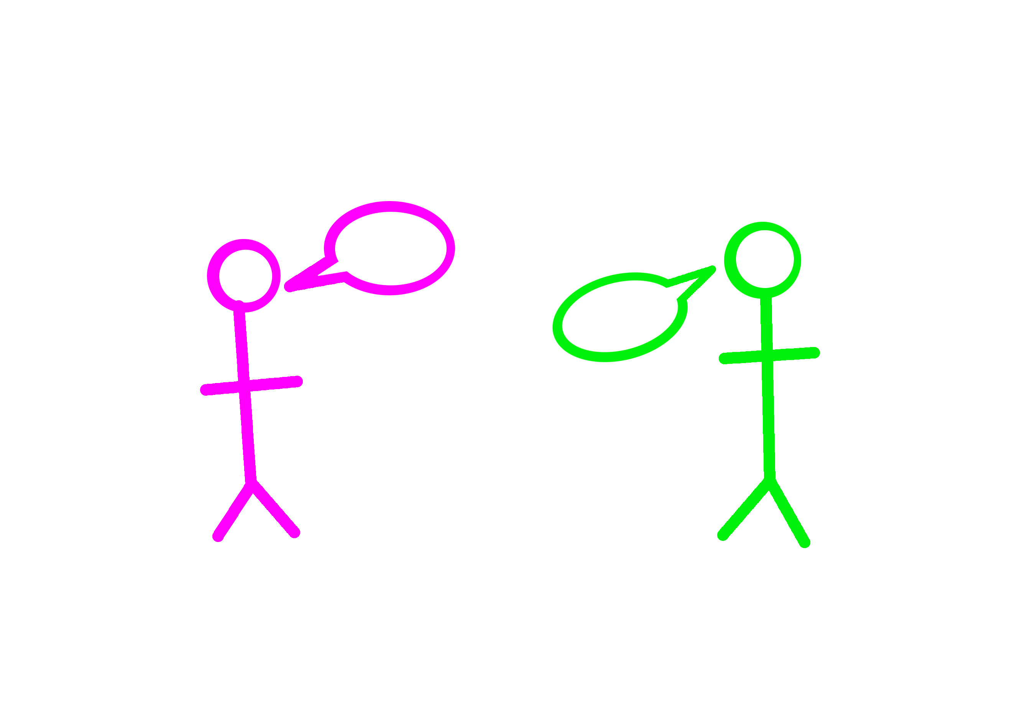
Communication principles
communication has purpose,
communication is continuous,
communication messages vary in conscious thought,
communication is relational,
communication is guided by culture,
communication has ethical implications,
communication is learned;
communication is contextual.

Slide 10
Stages of communication
Some rules for

Slide 11
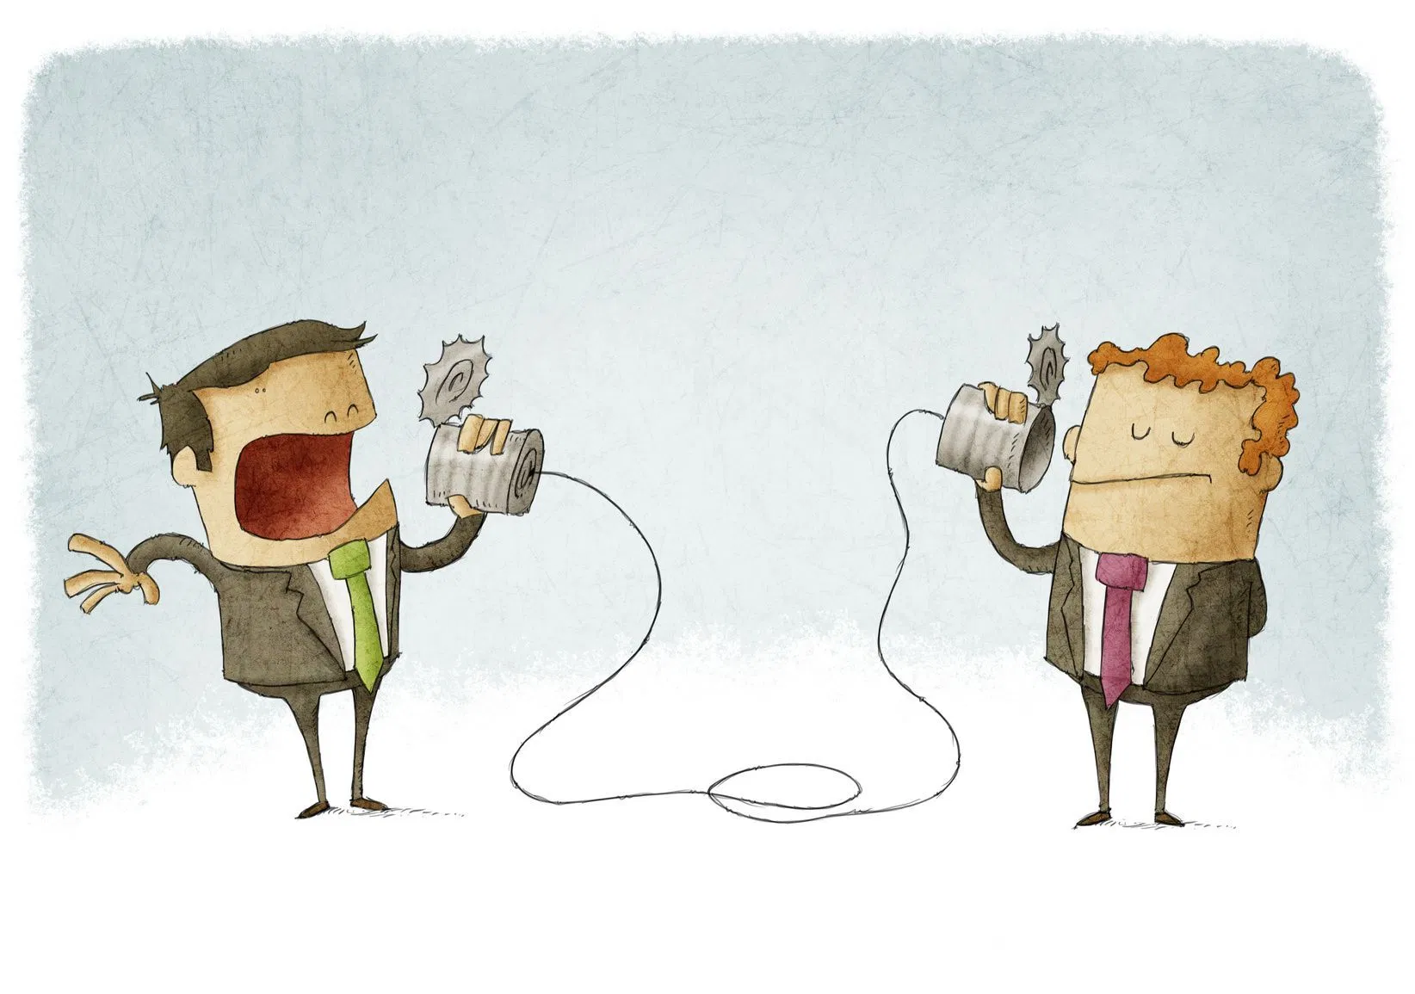
Rules for conveying information
Know who your recipients are – age, gender, state, culture, level of knowledge etc.
Think about their need, why they would need your message.
Clarify your goal for yourself – why you need to send them your message, what is your purpose.

Slide 12
“Golden Rule” of communication
“It does not matter what you say, it matters what people hear”.
Andrew Blotky

Slide 13
Rules of listening (absorption information stage)
Accept an active and open pose;
Confirm with gestures and facial expressions that you listen and understand;
Don't be distracted by other things (phone…);
Focus on the speaker's words, try to understand and remember the speaker's meaning, logic, main ideas and goals;
Do not make premature conclusions;
Ask the question correctly - in essence, tolerant, concise, interested.

Slide 14
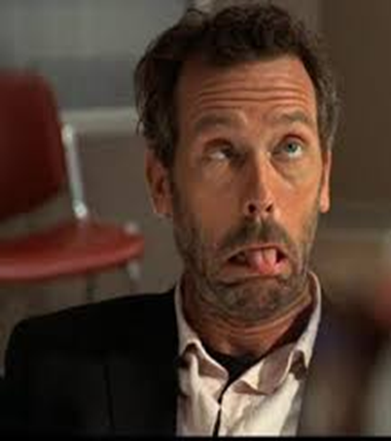
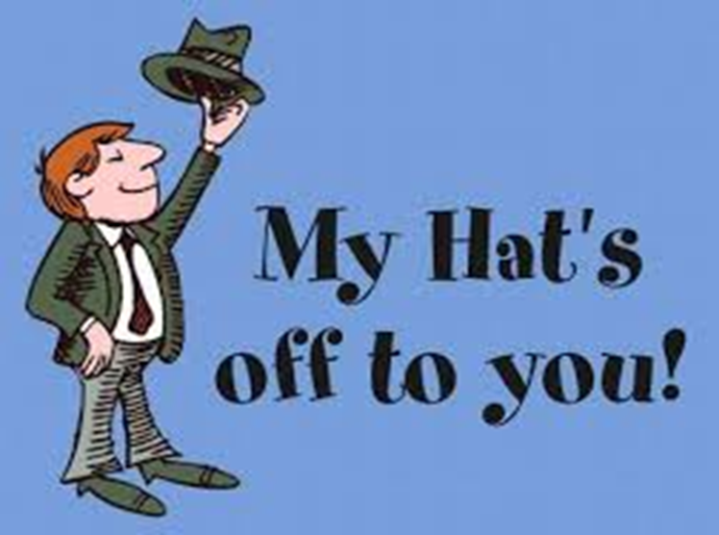
Giving and accepting feedback (reaction stage)
We get feedback all the time. Here are some examples:
people's facial expressions or body language in reaction to what you say or do;
people's casual comments about you ('that's a nice jacket') or your views ('why on earth do you think that film was good?');
people who seek (or avoid) your company;
tutors' or other students' responses to your comments in class;
things that work (or not) when you create or repair them.

Slide 15
Getting feedback
Giving feedback
Who gave it? What do they know?
When did they give it?
Does it make clear what was effective (or not) about what you did, said or thought?
What's the evidence for their views? Why do they think what they think?
What's the weight of evidence?
Thank them anyway.
Constructive feedback is respectful,
non-offensive, thoughtful,
restrained,
encouraging,
directed mostly on the person’s behavior/information rather than on his/her personality, and
adequate.

Slide 16
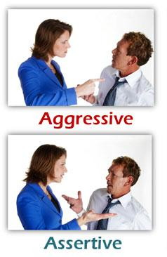
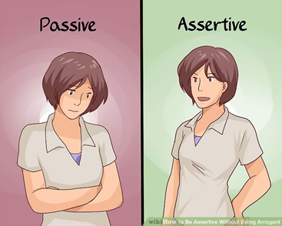
Styles of communication
In Source: The Anxiety and Phobia Workbook. 2nd edition. Edmund J Bourne. New Harbinger Publications, Inc. 1995.

Slide 17
1. The Assertive Style

Slide 18
The Assertive Style
Behavioural Characteristics
Non-Verbal Behaviour
Achieving goals without hurting others
Protective of own rights and respectful of others' rights
Socially and emotionally expressive
Making your own choices and taking responsibility for them
Asking directly for needs to be met, while accepting the possibility of rejection
Accepting compliments
Voice – medium pitch and speed and volume
Posture – open posture, symmetrical balance, tall, relaxed, no fidgeting
Gestures – even, rounded, expansive
Facial expression – good eye contact
Spatial position – in control, respectful of others

Slide 19
The Assertive Style
Language
People on the Receiving end Feel
They can take the person at their word
They know where they stand with the person
The person can cope with justified criticism and accept compliments
The person can look after themselves
Respect for the person
"Please would you turn the volume down? I am really struggling to concentrate on my studies."
"I am so sorry, but I won't be able to help you with your project this afternoon, as I have a dentist appointment."

Slide 21
The Aggressive Style
Non-Verbal Behaviour
Behavioural Characteristics
Frightening, threatening, loud, hostile
Willing to achieve goals at expense of others
Out to "win"
Demanding, abrasive
Belligerent
Explosive, unpredictable
Intimidating
Bullying
Voice – volume is loud
Posture – 'bigger than' others
Gestures - big, fast, sharp/jerky
Facial expression – scowl, frown, glare
Spatial position - Invade others' personal space, try to stand 'over' others

Slide 22
The Aggressive Style
Language
People on the Receiving end Feel
"You are crazy!"
"Do it my way!"
"You make me sick!"
"That is just about enough out of you!"
Sarcasm, name-calling, threatening, blaming, insulting.
Defensive, aggressive (withdraw or fight back)
Uncooperative
Resentful/Vengeful
Humiliated/degraded
Hurt
Afraid
A loss of respect for the aggressive person

Slide 23
3. The Passive-Aggressive Style

Slide 24
The Passive-Aggressive Style
Non-Verbal Behaviour
Behavioural Characteristics
Voice – Often speaks with a sugary sweet voice.
Posture – often asymmetrical
Gestures – Can be jerky, quick
Facial expression – Often looks sweet and innocent
Spatial position – often too close, even touching other as pretends to be warm and friendly
Indirectly aggressive
Sarcastic
Devious
Unreliable
Complaining
Sulky
Patronising
Gossips
Two-faced

Slide 25
The Passive-Aggressive Style
Language
People on the Receiving end Feel
"Why don't you go ahead and do it; my ideas aren't very good anyway"
"You always know better in any case."
"Oh don't you worry about me, I can sort myself out – like I usually have to."
Confused
Angry
Hurt
Resentful

Slide 26
4. The Submissive Style

Slide 27
The Submissive Style
Behavioural Characteristics
Non-Verbal Behaviour
Apologetic; Avoiding any confrontation
Finding difficulty in taking responsibility or decisions
Yielding to someone else's preferences
Opting out
Feeling like a victim
Blaming others for events
Refusing compliments
Inexpressive (of feelings and desires)
Voice – Volume is soft
Posture – make themselves as small as possible, head down
Gestures – twist and fidget
Facial expression – no eye contact
Spatial position – make themselves smaller/lower than others

Slide 28
The Submissive Style
Language
People on the Receiving end Feel
Exasperated
Frustrated
Guilty
You don't know what you want (and so discount you)
They can take advantage of you.
"Oh, it's nothing, really."
"Oh, that's all right; I didn't want it anymore."
"You choose; anything is fine."

Slide 29
5. The Manipulative Style

Slide 30
The Manipulative Style
Non-Verbal Behaviour
Behavioural Characteristics
Cunning
Controlling of others in an insidious way – for example, by sulking
Asking indirectly for needs to be met
Making others feel obliged or sorry for them
Uses 'artificial' tears
Voice – patronising, envious, ingratiating, often high pitch
Facial expression – Can put on the 'hang dog" expression

Slide 31
The Manipulative Style
Language
People on the Receiving end Feel
"You are so lucky to have those chocolates, I wish I had some. I can't afford such expensive chocolates."
"I didn't have time to buy anything, so I had to wear this dress. I just hope I don't look too awful in it." ('Fishing' for a compliment).
Guilty
Frustrated
Angry, irritated or annoyed
Resentful

Slide 32
6 principles how to enhance communication skills
1: Start with safety and reduce threat.
2: Built trust.
3: Listen to understand.
4: Ask good questions.
5: Create verbal and non-verbal congruence.
6: Stay low on the Ladder of Inference.
Halelly Azulay

Slide 33
Conclusion
Communication is complex and we need to enhance it all the time.
These rules are actionable and you can try to put them into reality right now to make your communication more effective.

Slide 34
QUESTIONS?
Notes:
34

Slide 35
Thanks for listening me!

