Slide 1
Course: Psychology of Communication General topic: Critical thinking and presentation skills
Lecturer: Olena Lutsenko
Professor of Department of Clinical Neurology, Psychiatry and Narcology

Slide 2
Today’s learning outcomes
Topic 3. Principles of critical thinking
Comparison of critical thinking and general intelligence. Basic definitions. A comparison of critical and ordinary thinking. Recommendations for critical reading and evaluation of information. Recommendations for effective writing of reports. The main elements of critical thinking. Techniques of verbal and written persuasion. Logical errors.
Topic 2. Presentation and self-presentation skills.
Basic definitions. Impression management. Visual, verbal and nonverbal means. Nervous control. Rehearsals.

Slide 3
Do you think that critical thinking is equal to general academic abilities?
IQ | Critical thinking
- verbal memory; - figural memory; - logical thinking; - figural-visual knowledge; - numerical knowledge; - general knowledge; - attention level etc. | - Understanding and use of oratory; - Prediction and prevention of problems; - Knowledge of "logical fallacies“; - Critical reading and writing style; - Recognition of statistics manipulating; - Recognition of manipulating in advertising and propaganda; - Techniques of dishonest dispute etc.

Slide 4
Definition
Critical Thinking is the analytical thinking which underlies all rational discourse and enquiry. It is characterized by meticulous and rigorous approach. As an academic discipline, it is unique in that it explicitly focuses on the processes involved in being rational. These processes include:
• analyzing arguments,
• judging the relevance and signiﬁcance of information,
• evaluating claims, inferences, arguments and explanations,
• constructing clear and coherent arguments,
• forming well-reasoned judgements and decisions.
Being rational also requires an open-minded yet critical approach to one’s own thinking as well as that of others.
(Black, 2012)

Slide 5
Comparison features of the ordinary and critical thinking (M. Lipman, 1988)
Critical Thinking / Reasoning | Ordinary Thinking
Estimating | Guessing
Evaluating | Preferring
Classifying | Grouping
Assuming | Believing
Inferring logically | Inferring
Grasping principles | Associating concepts
Hypothesizing | Supposing
Noting relationships among other relationships | Noting relationships
Making judgments with criteria | Making judgments without criteria

Slide 6
The main elements of critical thinking

Slide 7
Critical reading and evaluation information
Use the criteria: Who? Why? What? When?
Who? Look at the qualification of the authors and sources of experience. Whether they are experts in their field? Whether they are published anywhere else? Are they sponsoring by someone or not? Were they cited by other specialists in their field? Is the publisher recognized and authoritative organization? Do they provide contact information?

Slide 8
Why? Look at the purpose of the information. Whether the information is intended to inform, persuade, or entertain? Is there sufficient evidence that there have been no complaints? Were the studies sponsored? Is this objective or biased? Who is the target audience? Is it use emotional language?

Slide 9
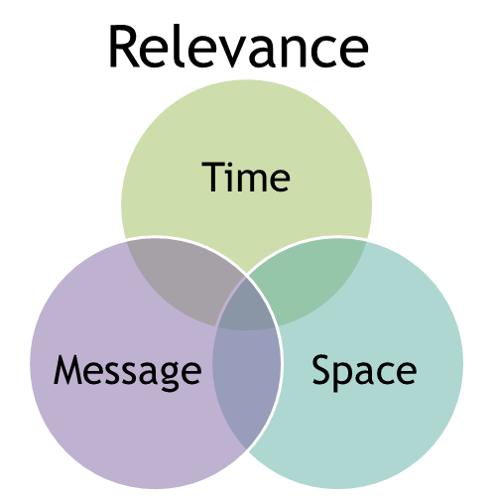
What? Look at the relevance of the information. Does it provide information at the appropriate level for your needs? Is this true in terms of geographic location? Is this an original or a secondary material? What this material is focused on? How limited is the coverage?

Slide 10
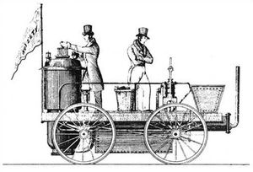
When? Look at the novelty of information. Is there a publication date? When was it last updated? Are the links still active (the site)?

Slide 11
Recommendations for effective report writing
To write well-structured report it need to involve such writing abilities:
Ability to draft an outline plan.
Ability to formulate the head of report.
Skills to write abstract if the report is long.
Ability to set up the goal and the tasks of your report.
Skills to structure materials and to design the detailed plan of your report.
Ability to formulate conclusions, to add necessary appendix.

Slide 12
Academic style of writing
The following characteristics are typical of academic writing:
Use of correct grammar and punctuation;
Use cautious (probabilistic) language;
Avoid subjective and emotive language;
Use linking words and phrases;
Use correct referencing;
Clear and concise language;
Formal writing style.

Slide 13
Techniques of verbal and written persuasion
These techniques show the reader that the point of view of the author should act as their own point of view.
1. Rhetorical question: means that the answer is so obvious that other answer is not required .
Example: Can we expect that our teachers will maintain a high level of professionalism, if we do not pay them a fair wage?
2. The Rule of ‘Three’: based on the theory that people remember things when they are listed in three. The same idea can be told in 3 different ways.
Example: "Stop, look, and listen"; “Is your car old? rusting? ready to be replaced?”

Slide 14
Techniques of verbal and written persuasion (continuation)
3. Emotional language: it is using adjectives (nouns, verbs), so that the reader could feel a certain emotion.
Example: Management will not stop these cuts, and all of our children will go hungry. Then they close the plant and leave us without work and on the street.
4. Hyperbole: The use of exaggeration for extravagant effect; often used humor.
Examples: "A hundred years have not seen," "I've said it a thousand times."

Slide 15
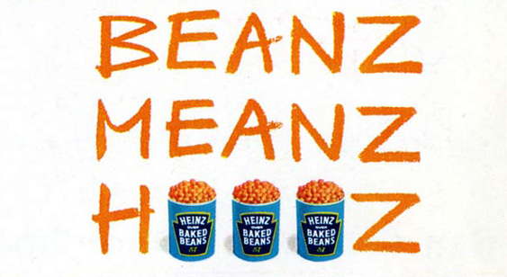
Techniques of verbal and written persuasion
5. Sound model: designed to attract the
reader's attention and remember the contents better:
- Rhyme, - alliteration (repeated one the same sound at the beginning of words), the repetition of the same consonant sound, repetition of vowel sounds. Examples: sweet smell of success; dime a dozen…

Slide 16
Techniques of verbal and written persuasion (continuation)
6. Comparisons: show a relationship between two unlike items in one of three ways:
metaphor
Examples of metaphor: ‘‘golden hair’’, ‘’sunny smile’’ .
simile (uses “like” or “as”)
Examples of simile: the foreman is tough as nails.
personification (uses an animal compared to a non-animal)
Examples of personification:
she eats like a pig;
he’s an ostrich — he won’t face
his problems.

Slide 17
Activity 1. Recognize rhetorical techniques
Texts
1. ‘’In conclusion, let me say that voting for this candidate - is a vote for a perfect world’’.
2. She is smart, sincere and successful.
3. She knows how to get things done. Other candidates want to take us back to a time when jobs are scarce, people were scared and the government intervened in the lives of people. Let's not let that happen.
4. Why turn the clock back, if we can move forward to a brighter future ?
Rhetorical techniques
Sound model _____
Hyperbole _____
Rhetorical question _____
“The Rule of Three” ______
Emotional language ______

Slide 18
Logical Fallacies
False Dilemma
Post Hoc (after this, therefore because of this)
Hasty generalization (Jumping to conclusion)
Unfinished claim
«Slippery Slope»
Circular Reasoning
Equivocation
“Red herring”
Composition fallacy

Slide 19
Logical Fallacies Examples
«Slippery slope». The argument might have two true premises, and a conclusion that takes them to an extreme.
Example: “We have to stop the tuition increase! Today, it’s $5,000; tomorrow, they will be charging $40,000 a semester!”
False dilemma - which presents in its major premise just two options (“either-or”) when in reality there are others.
Example: “Stop wasting my time in this store! Either decide you can afford the stereo, or go without music in your room!”

Slide 20
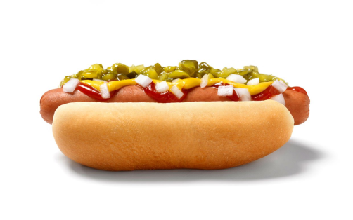
Logical Fallacies Examples (continuation)
Circular reasoning - there is just one premise, and the conclusion simply restates it in a slightly different form.
Example: “I told you to clean your room!” “Why?” “Because I said so!”
Equivocation - uses a word twice, each time implying a different meaning of that word, or uses one word that could mean at least two different things.
Example: “Hot dogs are better than nothing. Nothing is better than steak. Therefore, hot dogs are better than steak.“

Slide 21
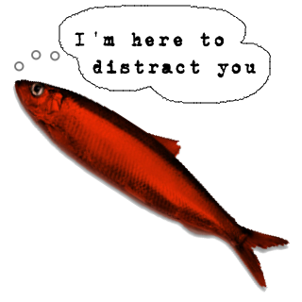
Logical Fallacies Examples (continuation)
“Red herrings” – are simply any unrelated topic that is brought into an argument to divert attention from the subject at hand.
Example: “Nuclear power is a necessity, even though it has the potential to be dangerous. You know what is really dangerous, though? Bathtubs. More people die in accidents in their bathtubs every year than you can imagine.”

Slide 22
Logical Fallacies Examples (continuation)
Post Hoc (after this, therefore because of this) – occurs when an assumption is made, because one event precedes another.
Example: A tenant moves into an apartment and the building's furnace goes faulty. The manager blames the tenant's arrival for the malfunction.
Hasty generalization – when premises do not contain enough evidence to draw a conclusion.
Example: That new police drama is a really well done show. All police dramas are great shows.

Slide 23
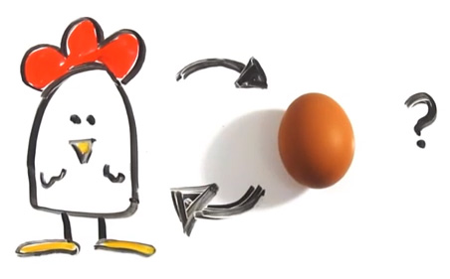
Logical Fallacies Examples
“Chicken and egg” fallacy - an error by confusing cause and effect.
Example: Last night I had a fever. This morning, I have a cold and a fever. The fever caused the cold.
Composition fallacy – by focusing on parts of a whole and drawing a conclusion based only on those parts. Example: Every player on their team is excellent. So their team must be excellent, too.

Slide 24
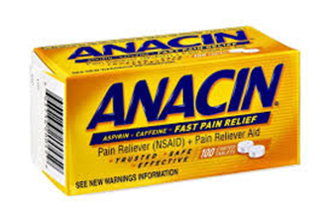
Logical Fallacies Examples (continuation)
Unfinished claim – when advertising claims the product is better, or has more of something, but does not finish the comparison.
Examples: "Magnavox gives you more." More what?
"Anacin: Twice as much of the pain reliever doctors recommend most."
Does not say twice as much of what pain reliever.

Slide 25
Example of statistics manipulation
Company claims it is edging out its competitor
with higher sales. They are stated that
they have had a 50% increase in sales, compared with only a 25% increase for their competitors.
Is their claim valid?
What if the competitor sold 2000 bicycles last year, and 2400 this year;
but the other company sold 40 bicycles last year, and 60 this year. Did they won the competition?

Slide 26
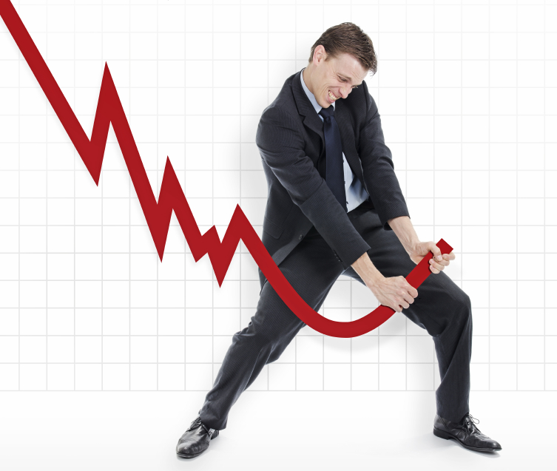
Prevention of statistics manipulation
Control questions:
Is this statistic reliable?
Is there no deliberate misrepresentation here?
Do they provide you with all the information you need to evaluate?

Slide 27
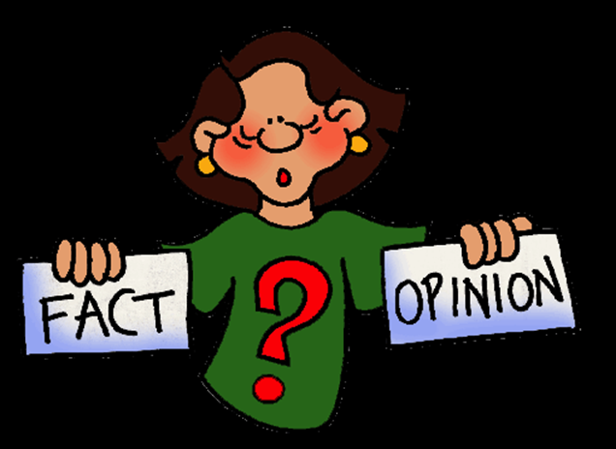
Activity 2. The distinction between facts and opinions
Mark each statement as (F) of fact or (O) opinion.
___ 1. World War II began on September 1, 1939.
___ 2. Cream Brylle is the most
delicious dessert.
___ 3. I went to rest in the
Carpathians in the past year.
___ 4. To invest in the stock
market is a bad idea.
____ 5. My presentation was great. Now the administration will pay attention to me.
____ 6. My presentation was great. This was noted in my attestation.
What is your conclusion – how can we find the difference?

Slide 28
PRESENTATION SKILLS (Impression management)

Slide 29
Impression management definition
Impression management is a goal-directed conscious or unconscious process in which people attempt to influence the perceptions of other people about a person, object, or event.
Verbal messages
non-verbal messages
with whom he/she/they associate
person’s age or gender or ethnic origin
what others have said about the person

Slide 30
Presentation Definition
A presentation is the set of techniques and skills required to successfully present oral information to others.

Slide 31
Presentation Skills
Three types of presentation
might be identified:
Information-giving
(lecture, report)
Demonstrative
(master-class, work-shop)
Discursive
(conference report, dissertation presentation)

Slide 32
Self-control questions before preparation presentation
What is the main aim of the presentation and what message you want to deliver to the audience in the time limit set?
What is the current knowledge level of the audience and what new knowledge or awareness do you want the audience to have gained from your presentation?
What is the most effective way to communicate this knowledge?

Slide 33
Preparation
6
prepare the ‘good enough’ set of slides
5
decide on the audio-visual aids that will be useful
4
3
review, revise and edit first version
2
put the presentation aside for a while
1
prepare the first set of slides
prepare the first draft of the presentation
(Burns, T., Sinfield, S., 2004)

Slide 34
Structure
Conclusion
The Main Body
Introduction

Slide 35
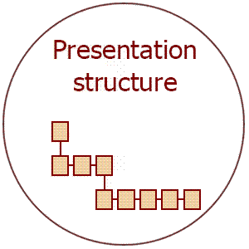
How to remember this structure?
1. Introduction. Tell them what you are going to tell them.
2. The main body. Tell them.
3. Conclusion. Tell them what you have told them.

Slide 36
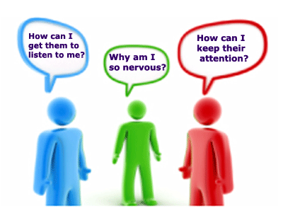
Introduction
It should previously inform audience about main content of your presentation;
You may do it in the form of presenting a series of statements, but can be better presenting a puzzle, picture or telling a story for catch audience attention. Be careful with a jokes;
Give the purpose or
outcomes of your
presentation to listeners;
Keep ‘needs’ of your
audience very firmly in mind.

Slide 37
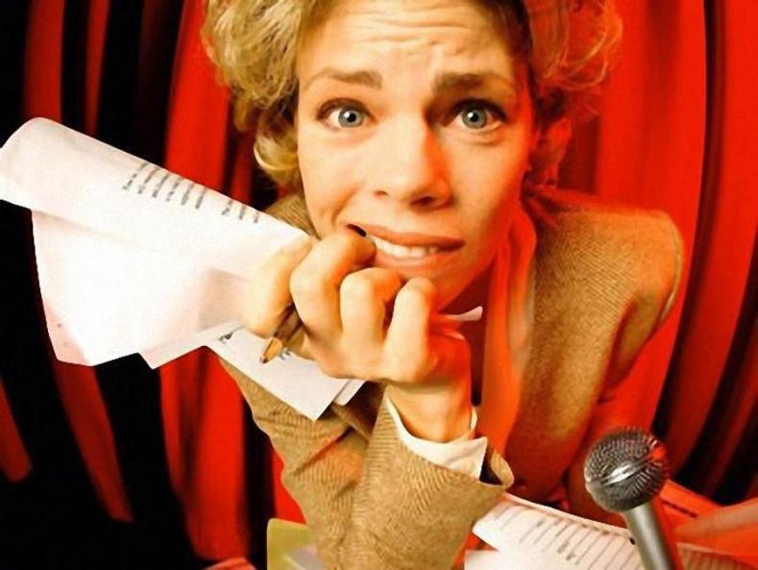
Avoid such phrases at the beginning
“I'm nervous / tired / jet lagged”.
“Sorry, we’re starting a little late”.
“Can you hear me well?”
“Can you read / see this?”
“I'll try briefly ...”
“Sorry for that mistake there”.

Slide 38
Main body of the presentation
3 or 4 main points for a presentation of up to a halfhour and no more then 7 main points for longer presentation;
Use examples, stories, statistics, quotes from expert sources, or research findings to support your ideas;
You may use questions or initiate discussion to activate listeners.

Slide 39
Conclusion
Tell to the audience what you have already said – repeat it again in short;
Always leave your audience with something memorable, say a powerful visual or a convincing conclusion, with a key idea, a central theme to take away and want to reflect on later.
Thank the audience for their attention and invite questions or discussion.

Slide 40
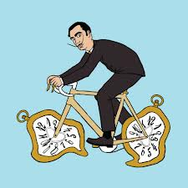
Tips for timing:
- It is usually better to
deliver less content at
a reasonable pace.
- You should fit the topic
into the time limit set
and plan time for breaks,
asides, questions.
- You should think clearly about what to include and exclude from the final version of your presentation.
(Chivers B., Shoolbred M., 2007)

Slide 41
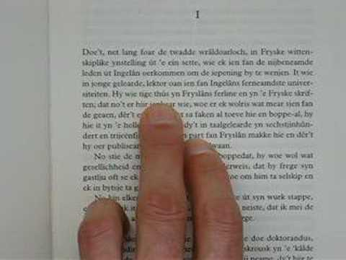
Form of language
Use explanations or definitions for new terms;
Use correct language and proofread;
- Avoid gender stereotyping;
- Avoid racist and national stereotyping;
- Avoid being aggressive, swearing or use obscenities;
- Use the language that can include everybody.
(Drew, S., Bingham, R., 2010)

Slide 42
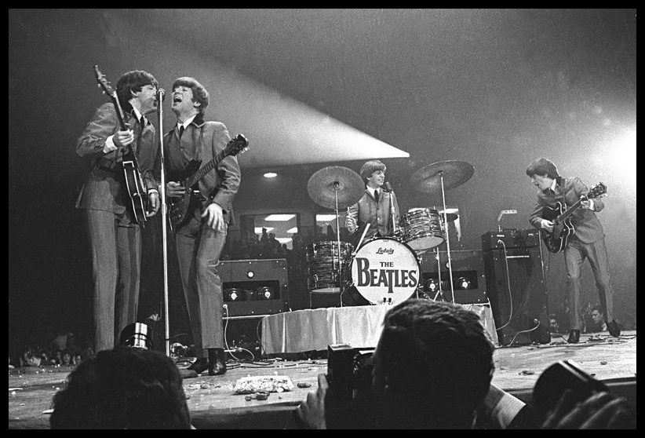
Environment:
type and size of room
acoustics
lighting
position of speaker
equipment

Slide 43
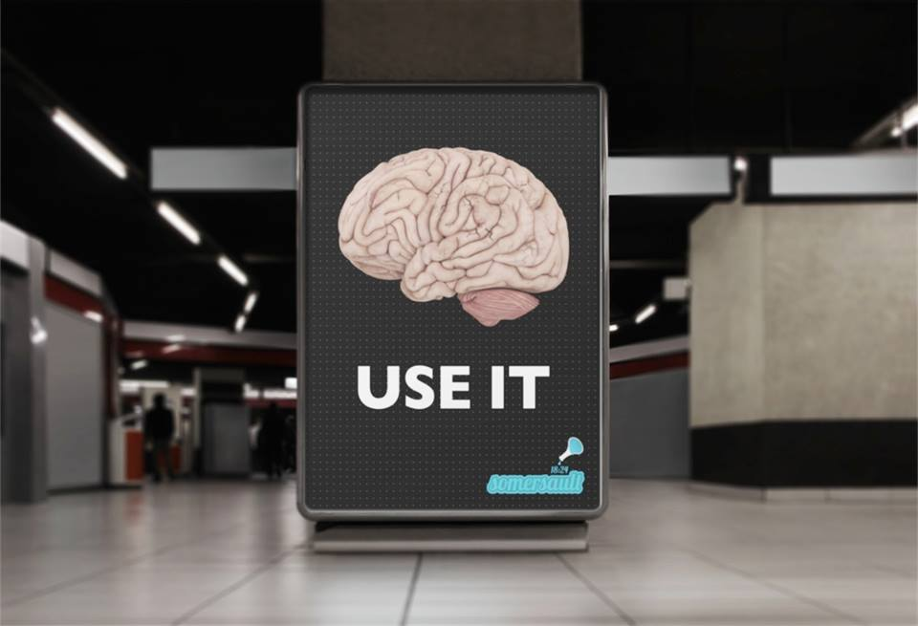
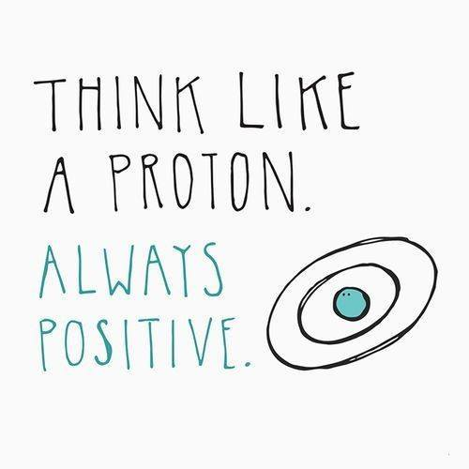
Use images
to improve understanding
for impact
to save time
for interest

Slide 44
Aspects of Personal Presentation
Your personal presentation includes:
Clothes;
Accessories:
your notes, luggage, bags, phones, jewellery, watches, and scarves;
Style of hair, nails, makeup (for women);
Body language and
Voice.

Slide 45
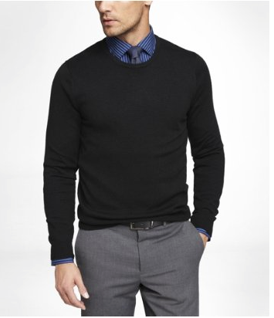

Slide 46
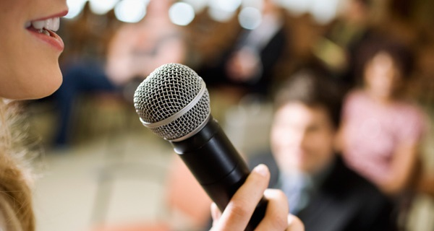
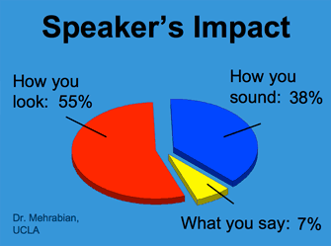
Verbal means and appearance
7% of what we understand comes from the words;
38% of information comes from the tone of voice;
Make sure that you project your voice to the back of the room.

Slide 47
Aspects of Effective Speaking
Accents.
Finding your voice.
The effect of breath on voice and speech.
Pauses.
Vocal production (Volume - to be heard. Clarity - to be understood. Variety - to add interest).

Slide 48
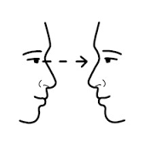
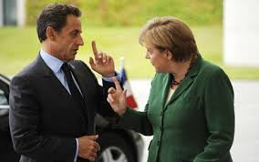
Presentation Skills
Non-verbal means
eye-contact
hand gestures
body language, timing and proxemics

Slide 49
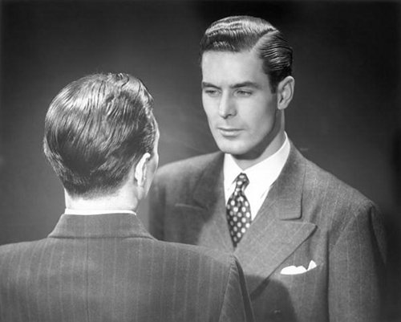
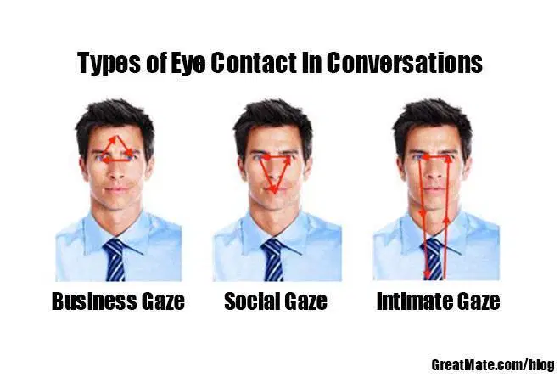
Eye contact

Slide 50
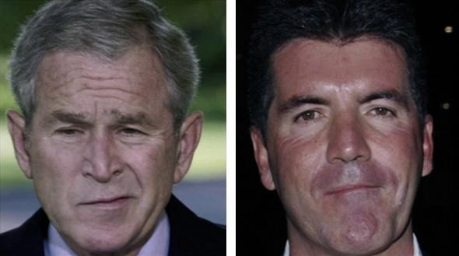
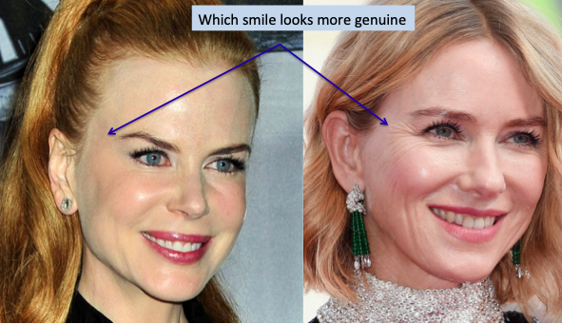
Facial expression

Slide 51
Posture

Slide 52
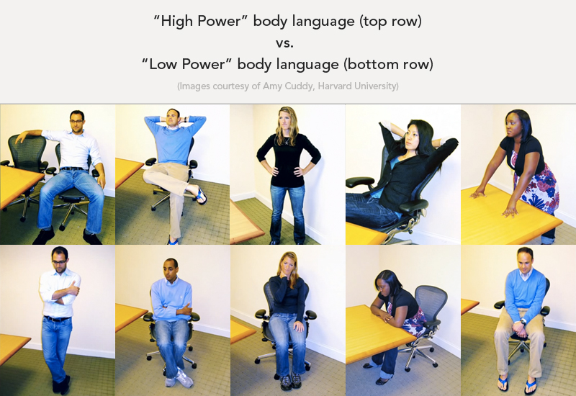

Slide 53
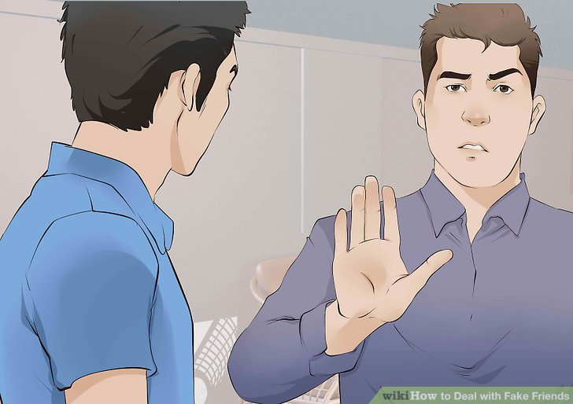
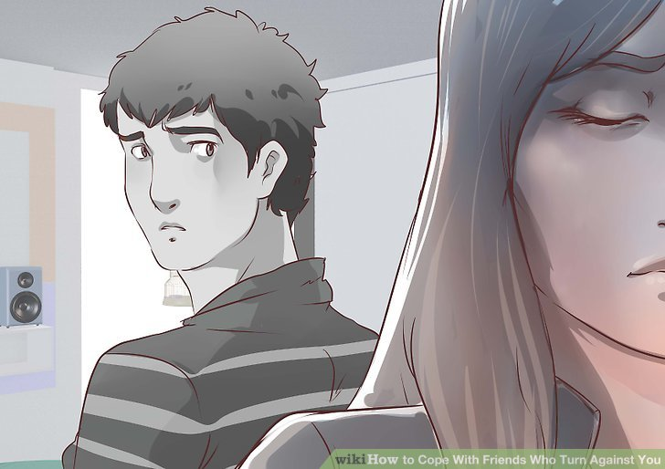

Slide 54
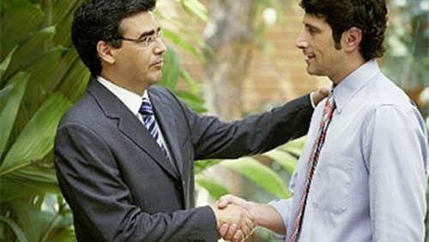
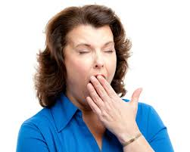
Touch and gestures

Slide 55
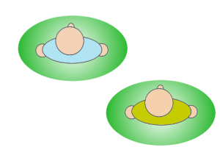
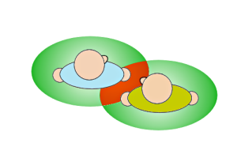
Proxemics (E. T. Hall)
Two people not affecting each other's personal space
Reaction of two people whose regions of personal space are in conflict

Slide 56
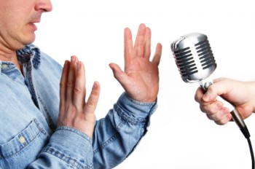
Handling nerves
get as much practice as you can;
concentrate on exposing yourself to similar situations;
practice deliberate relaxation, e.g. breathing techniques, visualization techniques;
drink water, smile, use pauses, slow down, move around, stop thinking about yourself;
prepare for each specific presentation.

Slide 57
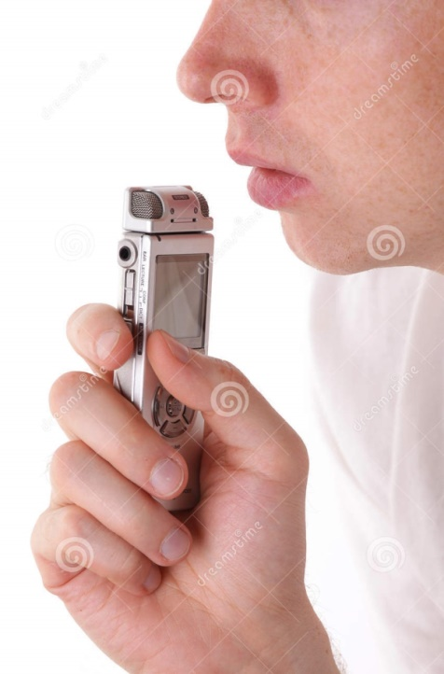
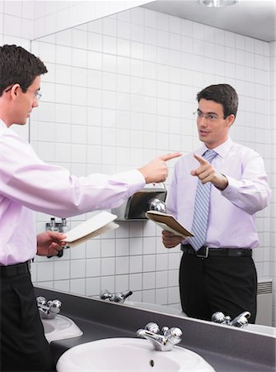
Rehearsal
Rehearse and learn the factual content and structure.
Rehearse speaking aloud.
Rehearse in front of a mirror or video
camera.
Time the rehearsals.
Rehearse before other people.
Rehearse in the similar physical environment.

Slide 58
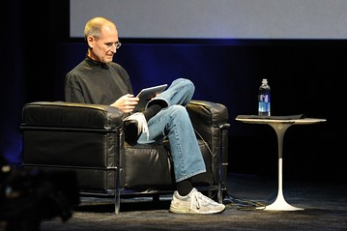
In conclusion…main about presentation and critical thinking
"Read not to contradict and confute; nor to believe and take for granted; nor to find talk and discourse; but to weigh and consider."—Francis Bacon When you are making a presentation, you are presenting a package: you and your message. The more you are aware of the impact of every element, the more effective the package will be as a whole.

Slide 59
QUESTIONS?
Notes:
59

Slide 60
Thanks for your attention!

