Slide 1
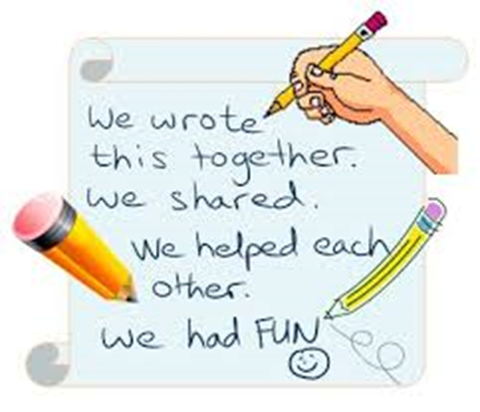
Group work
IMPRESS Project Soft Skills Team
Improving the Efficiency of Student Services
530534-TEMPUS-1-2012-1-UK-TEMPUS-SMGR

Slide 2

Learning outcomes
Effectively work cooperatively;
Contributing to groups with ideas, suggestions, and efforts;
Healthy respect for different opinions, customs, and individual preferences;
Ability to participate in group decision-making.

Slide 3
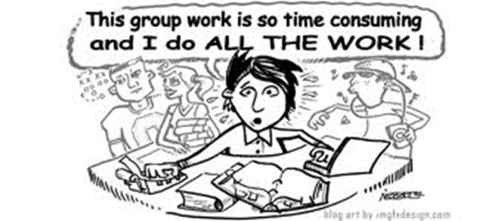
Why work in a group?
The personal benefits of group work are important: you will improve your communication and negotiating skills, and build rapport and friendships.
It provides solutions beyond the scope of individual effort.
It is one of the most useful ways of learning about cooperation, project planning, and time management.
Learning how to work successfully in a group has a close association with how we participate in the work place.

Slide 4

Why work in groups? (2)
To spread out responsibility.
Allows for more participation by the organization’s members.
Demonstrate diversity (i.e. values, beliefs, cultures, etc.).
Exposure to other viewpoints that an individual may have never considered.
Working in groups promotes an effective learning environment.

Slide 5
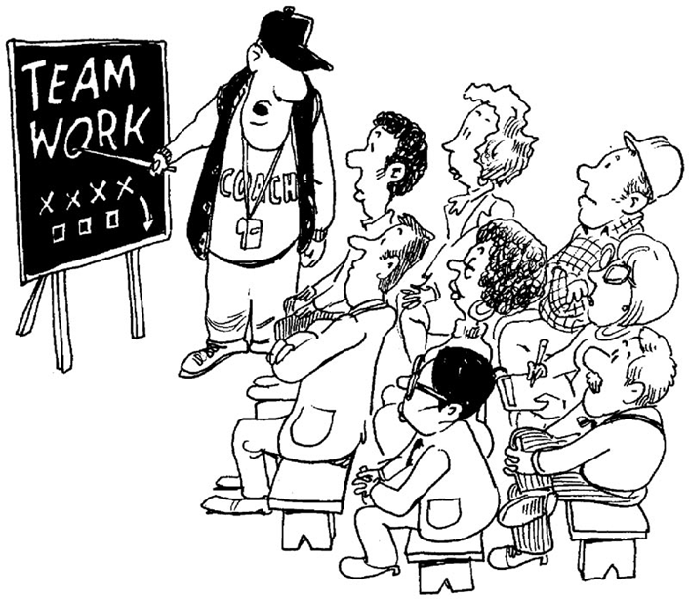
Definition of “GROUP WORK”
a method, used by professional social workers, of aiding a group or members of a group move toward individual adjustment and increased participation in community activity by exploiting the mechanisms of group life.
(Random House Unabridged Dictionary. http://dictionary.infoplease.com/group-work)

Slide 6

Connection between group size and time duration
Group size can vary in according to the
length of time that members work together.
Pairing is great for thirty-second or one-minute problem solving.
Groups that work together for ten to 45 minutes might be four or five people. (If there are more than four or five, some members will stop participating).
Maximum group size may be near 15. For example, such groups are eligible for focus-interview, brain-storm, group discussion, group project etc.

Slide 7
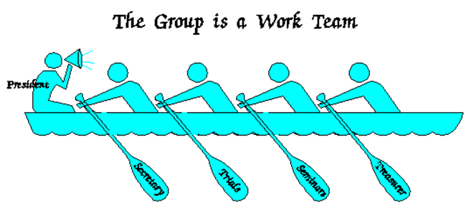
Groups can be formal or informal
Informal groups may be simple dyads (where each student turns to a neighbor) or ten-minute “buzz groups” (in which three to four students discuss their reactions to a reading assignment).
Formal group assignments can serve semester-long group projects.

Slide 8
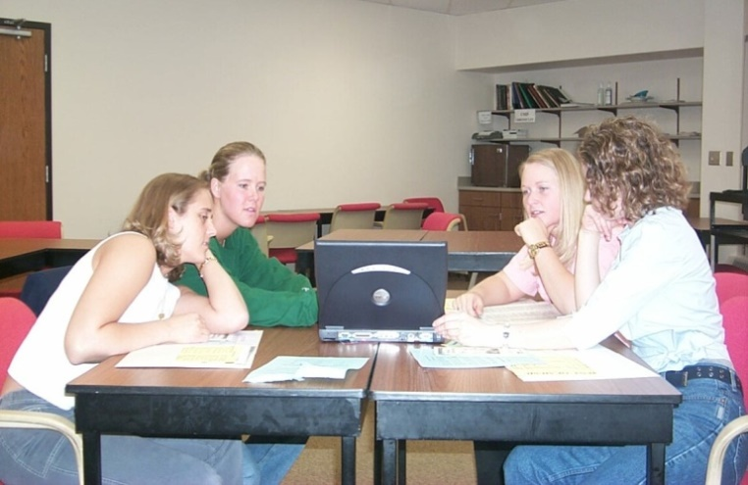
Characteristics of an effective group
Clear understanding of expectations;
Shared responsibilities, equitable participation from all members;
Open lines of communication, discuss irritations before they develop into a problem;
Completes assigned tasks in timely manner;
Members listen to each other.

Slide 9
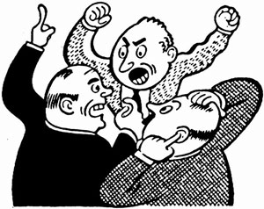
Dysfunctional Group
Members are confused about what the task to be completed;
Most members tend to be slackers;
Members don’t communicate openly, assume that others know what they are thinking;
Difficulty in finishing tasks on time.

Slide 10
Roles Within a Group
Leader – keeps the group on task,
takes charge;
Active Participant – give own opinion, prepared, discuss or support others points of view;
Follower – goes along with what other group members think, no individual opinions;
Distracter – prevents the group from performing its task (talks, laughs, doesn’t pay attention);
Non-participant – doesn’t talk much, not prepared, provides minimal input to the finished product.

Slide 11

Six stages in group work
Getting to know your group;
Setting the ground rules;
Planning the work and establishing roles;
Doing the work;
Monitoring progress;
Reflecting and assessing.

Slide 12
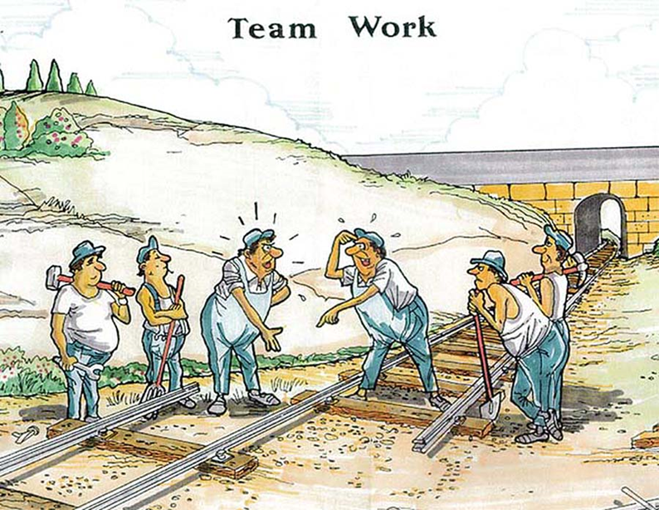
Techniques used in group work
Brain storming;
Buzz grouping;
Controlled discussion;
Free discussion;
Games and simulations;
Role play;
Snowballing.

Slide 13
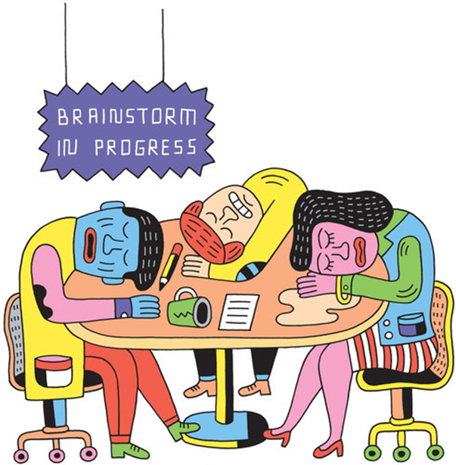
Brainstorming is
a group creativity technique by which efforts are made to find a conclusion for a specific problem by gathering a list of ideas spontaneously contributed by its members.
This group work format has two stages – without critics and with critics.

Slide 14
Benefits of brainstorming
Is highly motivating.
Promotes spontaneity and creativity.
Is efficient and productive. Scores of ideas and suggestions or problems and obstacles can be listed in a few minutes.
Involves participants in the ownership of ideas. Problem solving is made much easier when communal commitment is guaranteed.
Provides a permanent record and aids in developing solutions to problems.

Slide 15
A buzz group is
a small, intense discussion group usually involving up to 3 persons responding to a specific question or in search of very precise information.
The full plenary group is subdivided into the small groups. It’s called a ‘buzz’ group because it mimics the sound of people in intense discussion (as noise of bees)! How to use
The learners are divided into small groups, usually twos or threes. These small groups meet for a short period to consider a simple question or problem. The ideas, thus exchanged, may then be presented to the other participants by each of the small groups in turn, so promoting further discussion.

Slide 16
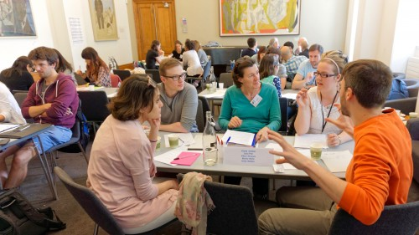
Benefits of a buzz groups
Highly participative.
Very focused and direct.
Very frequently it integrates theory with experience.
Short, intense and using members own information so there is ownership of the output by all members.

Slide 17

Activity. Let’s try buzz group discussion
Divide on threes and discuss this problem – do we need curator for every students group at our University? – 3 minutes
The related questions:
Why students so rarely visit curator’s hour?
Why they don’t keep initiative (or very seldom) to organize any events or excursions for curator’s hours?
Why students don’t ask (or very seldom) their curator for help in solving personal, interpersonal and learning problems?
Share small group’s opinions for whole audience and formulate your general opinion – 10 minutes

Slide 18
Controlled discussion
a type of meeting, but it differs from the formal meetings in a number of ways:
It may not have a specific goal – many group discussions are just that: a group kicking around ideas on a particular topic. That may lead to a goal ultimately...but it may not.
It’s less formal, and may have no time constraints, or structured order, or agenda.
Its leadership is usually less directive than of a meeting.
It emphasizes process (the consideration of ideas) over specific tasks to be accomplished.
Leading a discussion group is not the same as running a meeting. It’s much closer to facilitation.

Slide 19
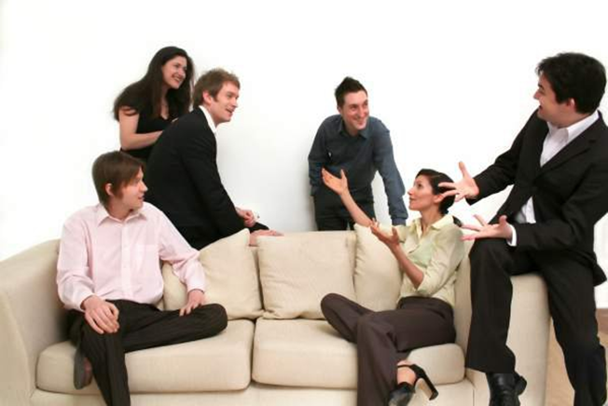
Free discussion
a form of inquiry and discussion between individuals, based on asking and answering questions to stimulate critical thinking and to illuminate ideas.
It is a dialectical method, often involving a discussion in which the defense of one point of view is questioned; one participant may lead another to contradict himself / herself in some way, thus strengthening the inquirer's own point of view.

Slide 20
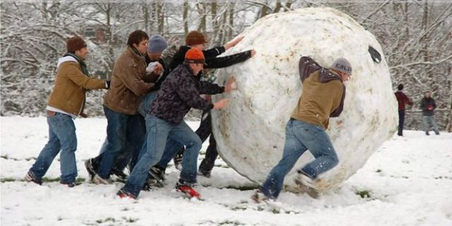
Snowballing
This method involves progressive doubling: members first work alone, then in pairs, then in fours, and so on. In most cases, after working in fours, members come together for a plenary session in which their conclusions or solutions are pooled.
It is good to provide a sequence of increasingly complex tasks so that members do not become bored with repeated discussion at multiple stages.

Slide 21
Activity: Snowballing group work
Now we start decide problem in “Snowballing format”.
Problem: Mobbing (workplace bullying) often appearing in organizations. How to prevent it?
Mobbing – it is a form of aggressive persecution of one or several members of the group by one or several other members. It includes emotional abuse to force someone go out of the workplace through rumor, intimidation, humiliation, discrediting, and isolation.
We start from individual work – everybody write their solutions during 5 minutes.

Slide 22
Snowballing group work (2)
Next you gather in pairs, join your ideas and design common solution – during 5 minutes.
Next you gather in forth, join your ideas and design general plan for solving this problem – during 7 minutes. Think and take in account in your solution the motivation of bullies – why do they do this aggression?

Slide 23

Snowballing group work (3)
Next discuss in whole audience your decisions and design general plan to solve the problem – during 15 minutes.
Elect the leader and present your plan for audience (e.g. in press-conference) – during 5 minutes. You can use tribune, microphone, board.

Slide 24

Thanks for your attention and activity!

