Slide 1
Leadership
Olena Lutsenko, Ph.D., Associate Professor of Applies Psychology Department of V.N. Karazin Kharkiv National University with aid of Lily Cushenbery, Ph.D., Assistant Professor of Management, Stony Brook University

Slide 2
Learning outcomes
To know basic theories of leadership.
Be able to describe the famous styles and types of leadership.
To understand their benefits and vulnerabilities.
To define leadership errors and their peculiarities.
To understand the ways to recover from these errors.

Slide 3
Definition
Leadership is a process whereby an individual influences a group of individuals
to achieve a common goal. P. Northouse

Slide 4
Trait Theories (E. Bogardus et al.)
Congenital set of characteristics (charisma):
Intelligence;
Dominance;
Sociability;
Confidence;
Initiative;
A sense of humor;
Enthusiasm
and others ... about 80!

Slide 5
Theories of interaction style (A. Yago, etc.)
Leadership is a process of interaction between the leader and the followers:
Depends on the way the leader interacts with the followers;
May be a learning result;
Accessible to anyone;
Depends on the situation.

Slide 6
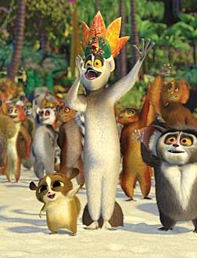
Leadership as a function of the group (G. Homans et al.)
A leader is understood as a person who, to a greater extent, than all other members of the group, meets its expectations and most consistently adheres to the norms and values adopted in it - "The Retinue plays the King".
Contradiction:
"Idiosyncratic credit" - trust, which has a leader from the group on deviation from the norms accepted in it.

Slide 7
Synthetic Leadership Theories
Theories that take into account the personality traits, the style of interaction, the peculiarities of the social group and situation - F. Fiedler, B. D. Parigin, etc.: emotional leader, business, moral leaders, leader-motivator, leader-organizer, universal, situational, etc.

Slide 8
The styles of leadership by K. Lewin - an authoritarian style
Formal side | Content side
Business, short orders; Prohibitions without exception, with threats; Clear language, unfriendly tone; Praise and punishment are subjective; Emotions are not taken into account; Examples display is not a system; The position of the leader is above the group. | Tasks are planned in advance in full; Only the immediate goals are defined, the future ones are unknown; The leader’s word is decisive.

Slide 9
Leadership styles by K. Lewin - democratic style
Formal side | Content side
Instructions in the form of proposals; Friendly tone; Praise and punishment with tips; Orders and prohibitions - with discussions; Leader position - inside the group. | Group activities are planned not in advance, but in the group; All members are responsible for the implementation of the proposals; All parts of the work are not only offered but also discussed.

Slide 10
Leadership styles by K. Lewin – laissez-faire style
Formal side | Content side
Tone - conventional; Lack of praise or punishment; No cooperation; The leader's position is not visible, "from the side of the group." | Affairs in the group go by themselves; The leader does not give directions; The tasks of the work go from the individual interests of the group members or go from the new leader.

Slide 11
Consequences of using different styles
Authoritarian:
"+" More work is done; high speed
"-" Low motivation, less originality, less group cohesion, lack of collective thinking, greater aggressiveness, anxiety, conformism, dependent and submissive behavior.
Laissez-faire:
"+" More game, more autonomy;
"-" The scope of work is lower, the lower quality of work, the goals are often not achieved.
Democratic:
"+" High quality of decisions, high motivation, less load on the leader;
"-" The complexity of ensuring the conditions for effective work, the process of work and decision-making is slower.

Slide 12
Transformational Leadership
A process of engaging with others to create a connection that increases motivation and morality in both the leader and the follower.
Burns (1978)

Slide 13
Core elements of TL:
A concern with emotions, values, ethics, standards, and long-term goals.
Includes assessing followers’ motives, satisfying their needs, and treating them as full human beings.

Slide 14
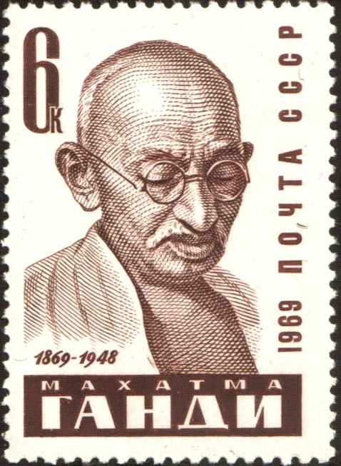
Transformational leaders

Slide 15
Transactional Leadership
Focuses on the exchanges that occur between leaders and their followers
Burns (1978)
Notes:
This is a contractual management style. Transactional Leaders
do not individualize the needs of subordinates nor focus on their personal development
exchange things of value with subordinates to further each others’ agendas

Slide 16
No new taxes = votes
Sell more cars = bonus
Turn in assignments = grade
Surpass goals = promotion
Notes:
The exchange dimension is so common that you can observe it at all walks of life.

Slide 17
While transformational leadership focuses on change within an organization, the goal of transactional leadership is generally to maintain consistency by reinforcing existing rules.
Vera & Crossan (2004)

Slide 18
Negative Effects of Transformational Leadership
Burnout: Getting subordinates to do “more than expected” is not always such a great thing
Can be seen as manipulative and serving of those higher up in the organization

Slide 19
Transformational and transactional leadership does not always contradict each other.
They can be complementary levels of leadership.

Slide 20
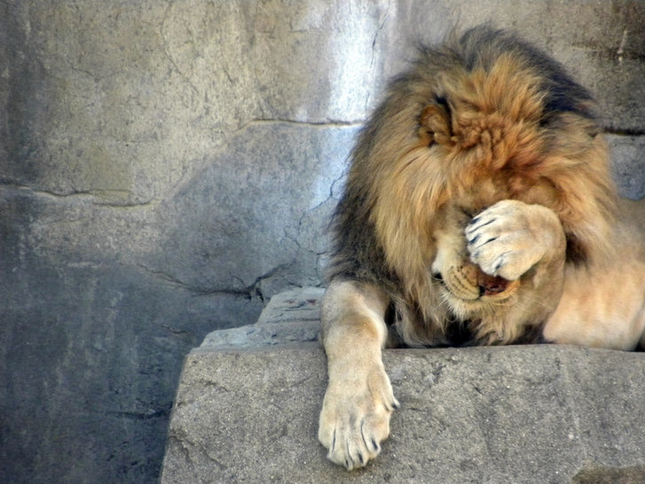
Leader Mistakes: How they happen and what you can do about them

Slide 21
What is a leader error?
An avoidable action or inaction is chosen by a leader which results in an initial outcome outside of the leader’s original intent, goal, or prediction
Hunter, S. T., Tate, B. W., Dzieweczynski, J., & Cushenbery, L. (2010).

Slide 22
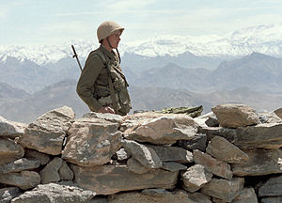
Famous leader’s errors
Stalin’s ignoring of warnings and unpreparedness before Hitler's attack, 1941
Unpreparedness USA for attack on Pearl Harbor, 1941
USA invasion in the Bay of Pigs, Cuba, 1961
The Three-mile island, the largest nuclear accident in the United States, 1978
Soviet invasion of Afghanistan, 1979
“Challenger“ catastrophe, 1986

Slide 23
How are mistakes unique for leaders?
A leader’s role is
complex
thus errors are more
likely
Hunter, S. T., Tate, B. W., Dzieweczynski, J., & Cushenbery, L. (2010)
Notes:
First, a leader’s role is a complex interaction of quick decisions, imperfect information, and many moving parts. These circumstances make errors more likely to happen.

Slide 24
How are mistakes unique for leaders?
A leader’s role is
public
thus errors are more
visible
Van Dyck, Frese, Baer, & Sonnentag (2005)
Notes:
As a result of their positions of power, leaders are considered public figures within (and sometimes beyond) their organizations. Their positions require them to be involved in others’ errors and role model an appropriate response to failure. Furthermore, as the people who are in charge of maintaining high performance in organizations, leaders may be held to higher standards for behavior. Society tends to associate errors with incompetence (Edmondson, 1996), a view that is especially problematic for the figures that are entrusted with authority over others.

Slide 25
How are mistakes unique for leaders?
A leader’s role is
influential
thus errors are more
harmful
Davidhizar & Laurent (2000)
Notes:
Finally, leaders have a lot of influence on their organizations. Errors can cause conflict, and Davidhizar and Laurent (2000) suggested that interpersonal conflict between leaders and followers results in lower personal and team productivity. Since leaders are so influential and all leaders make mistakes, this brings us to an important question…

Slide 26
Error Recovery Strategies
High
APOLOGIZE
JUSTIFY
Leader Accountability
EXCUSE
DENY
Low
Tata (2000)
Notes:
Tata 2000 discusses four general categories of recovery strategies. These vary on the amount of accountability associated with each.

Slide 27
Apology
Take responsibility for the mistake and show regret.
“I’m so sorry for what I did.”
APOLOGIZE
APOLOGIZE
JUSTIFY
EXCUSE
DENY
Tata (2000)
Notes:
Lazare 2004: remorse, acceptance of responsibility, admission of wrongdoing, acknowledgment of harm, promise to behave better, request for forgiveness, offer of repair, and explanation
Positive: Van Dyke et al. 2005: Talking about the error can teach effective strategies for error recovery
Negative: Zechmeister et al. 2002: Less effective than other recovery tactics

Slide 28
Justification
Attempting to make error seem legitimate under the circumstances.
“I know that hurt you but I think you’ll see that I did it for your own good (and I would do it again).”
APOLOGIZE
JUSTIFY
EXCUSE
DENY
Schoenback, 1990
Notes:
A justification is a hybrid of an apology and an excuse
Justifications have less of an influence since they admit both causality and responsibility, but justifications minimize or deny blameworthiness by claiming that the action was not offensive. Heider (1958) suggested that even when a person is held responsible for an action, justifications can mitigate the behavior and decrease blame.
Other leaders such as David Morgan have framed potential failures as a personal choice; a product of a favorable, entrepreneurial risk-taking behavior for business leaders, so that when mistakes were realized, the public may be more predisposed to sympathy. In this way, Morgan successfully convinced them that although potential failure was likely, the potential gain made his choice worthwhile. Morgan confesses to Westpac’s risk- averse organizational culture as one of their weaknesses, contending that not making enough mistakes is a weakness of its own:
You want people to make mistakes—people who don’t make mistakes probably aren’t doing enough. We had an issue internally in the mid to late 90’s, that, as a result of a reaction to mistakes in the 80’s, we became too risk-averse as a culture. So a lack of mistakes may, in fact, not be a good thing for the organization—it can be a symptom of timidity. (CEO Forum Group, 2006, para. 35)
Paradoxically, Morgan links “a lack of mistakes” to “a symptom of timidity,” using the metaphor of “symptom” to imply that a failure-free organization is “ill.” Morgan frames failure as a positive thing and suggests that the propensity to make mistakes, which is traditionally regarded as a flaw, is in fact a virtue. He, in effect, protects himself from future public backlash and a loss of reputation for potential failures by suggesting that the existence of some mistakes in his company could in turn be seen as a product of his daringness to take risks for the greater advancement of the company— perhaps even as a sign of courage.

Slide 29
Excuse/Blame
An explanation that includes a mitigating circumstance
“I made that mistake because I was under a lot of time pressure and I had to make a decision quickly.”
APOLOGIZE
JUSTIFY
EXCUSE
DENY
Schoen, 1990; 2000 Tata (2000)
Notes:
Excuses, however, minimize or deny responsibility by attributing the action to unintentional or external causes.
Blaming others may help the leader save face, make the situation seem less severe or enduring (such as blaming the economy for lay-off decisions), and increase subordinates perceptions of organizational justice
But suggesting that others have influence over their responsibilities undermines their power as a leader (Lee & Robinson, 2000).
Excuses have been shown to reduce subordinate anger towards the boss and complaints to the manager’s superiors (Bies et al., 1998).
***As suggested by Snyder and Higgins (1998), excuses can help a leader see their own mistake in a more positive light
George Trumbull and Al Dunlap, who persistently insist that the failures attributed to their leadership during their Australian tenures were of no fault of their own.
Blame can also be attributed to the company. For instance, a bureaucratic organizational culture that existed before the leader’s arrival, as cited in Al Dunlap’s case with Consolidated Press, or the ineptitude of one’s employees and followers, as in George Trumbull’s case at AMP.

Slide 30
Denial
No response or an outright refusal to admit wrongdoing.
“Did you see the nice weather today?”
or
“I didn’t do anything wrong. What are those people trying to get out of attacking me?”
APOLOGIZE
JUSTIFY
EXCUSE
DENY
Eubanks et al. 2010; Ferrin, Cooper, Kim, & Dirks, 2007
Notes:
Denials can be considered the most mitigating type of account since they claim that the offensive action did not take place. As such, denials minimize or deny causality, the lowest level of accountability. Errors are embarassing and leaders may think that admitting to them may make them look incompetent. Weiner et al. (1987) found that giving no excuse for coming late was rated similarly as giving a bad excuse – HOWEVER, this study used participants in equal roles, and this finding may be different for leaders addressing groups of people rather than individuals. Ignoring an error is less disruptive.

Slide 31
Vulnerabilities of the strategies
Excessive apologies show that the leader is incompetent.

Slide 32
Vulnerabilities of the strategies
Excessive excuses show that the leader does not affect the situation.

Slide 33
Vulnerabilities of the strategies
Abuse of deny shows that the leader does not deserve trust (dishonest).

Slide 34
How to choose a recovery strategy?
You can choose combinations or look for a strategy that is more optimal in this context.
Studies show that honesty is more important because it can not be restored, and competence can be restored.
Mistakes can be used as means of learning and if demonstrate this to people, it can turn them into your resources.

Slide 35
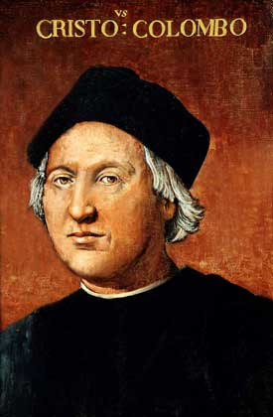
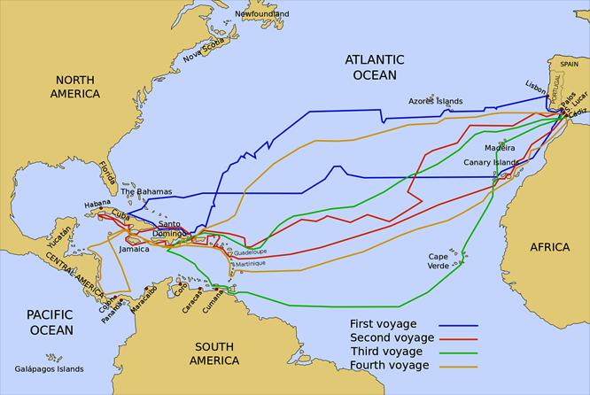
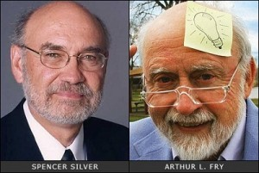
«Positive errors»
Sometimes mistakes lead to unexpected positive results.
Such positive outcomes include training, increased resilience, creativity, and the emergence of innovation (van Dyck, Frese, Baer, & Sonnentag, 2005; Sitkin, 1996; Dormann & Frese, 1994).

Slide 36
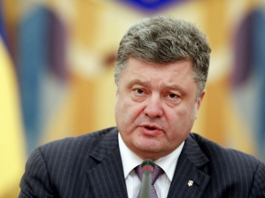
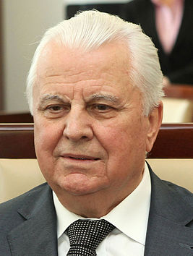
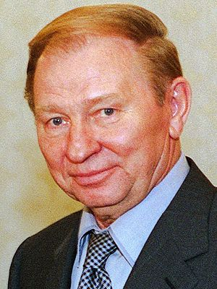
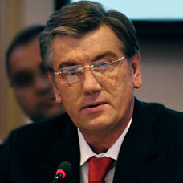
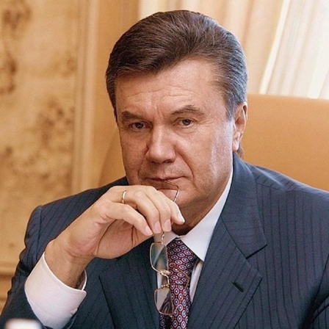
Activity – group discussion
The purpose of the task is the transfer of knowledge.
Remember the Presidents of Ukraine or other countries and determine their leadership traits / leadership styles. Can you note any their errors?
5-10 min for self-replies.
10-15 min for discussion.

Slide 37
Mistakes are a part of leadership.
Get ready to deal with them.

Slide 38
Structure of the Soft Skills Course
Self-management
Academic debate
Peer-to-peer Interaction
Group work
Presentation skills
Reflective thinking and writing
Critical thinking
Leadership
Notes:
38

Slide 39
Theme Assessment Scores
# | Forms of learning | Maximum mark | Minimum mark
1 | Work during contact hours | 32 | 0
2 | Presentation | 5 | 0
3 | Essays, PDP, Learning Log | 15 | 0
4 | Academic debate | 8 | 0
5 | Reflective essay (final) | 20 | 0
6 | Answers to 2 questions in writing (final) | 20 | 0
 | Total | 100 | 0

Slide 40
Questions?
Notes:
40

Slide 41
Thank you for your attention and activity!

